Slide 1
Introduction to Object oriented Software Design

Slide 2
At the beginning of the computing era, programming was usually limited to machine language programming(0’s and 1’s)
It’s actually impossible to develop software used in today’s scenarios with sequences of bits. This was the main reason programmers moved on to the next generation of programming languages, developing assembly languages, which were near enough to the English language to easily understand. These assembly languages were used in microprocessors.

Slide 3
High Level Language
A high-level language is a programming language that is designed to make it easier for humans to understand and write.
It is closer to natural language and uses commands and instructions that are more abstract and less dependent on the specific details of the underlying computer hardware.

Slide 4
Programming Paradigm
A programming paradigm refers to a pattern of programming.
It is an idea or a methodology or a set of principles that have been followed for writing software applications and designing programming languages and frameworks.

Slide 5
Most styles of programming or programming language themes can be broadly categorized into three types based on their design, structures, principles, rules, and practices:
Object-Oriented Programming (OOP)
Procedural Programming

Slide 6
Procedural Programming
In procedural programming, we work with procedures, also known as routines, subroutines, or functions.
A procedural language is a type of programming language that follows a sequential, step-by-step approach to solve problems.
A procedure is essentially a sequence of instructions or computational steps to be executed.
Therefore, procedural programming is all about the idea of getting things done in a sequence of steps.

Slide 7
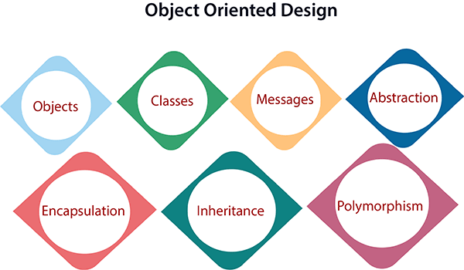
In the object-oriented design method, the system is viewed as a collection of objects (i.e., entities). The state is distributed among the objects, and each object handles its state data.
Similar objects create a class. In other words, each object is a member of some class.

Slide 8
What Are Objects?
An object is an entity that has states and behaviors.
For example, dog, cat, and vehicle. To illustrate, a dog has states like age, color, name, and behaviors like eating, sleeping, and running.
State tells us how the object looks or what properties it has.
Behavior tells us what the object does.
An Object can be defined as an instance of a class.

Slide 9
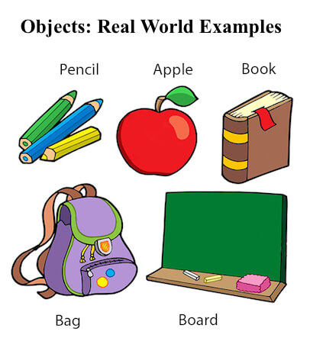
Example
Dogs have states (name, color, breed, hungry) and behaviors (barking, fetching, wagging tail).

Slide 10
Classes
class is a group of objects that have common properties.
It is a template or blueprint from which objects are created.

Slide 11
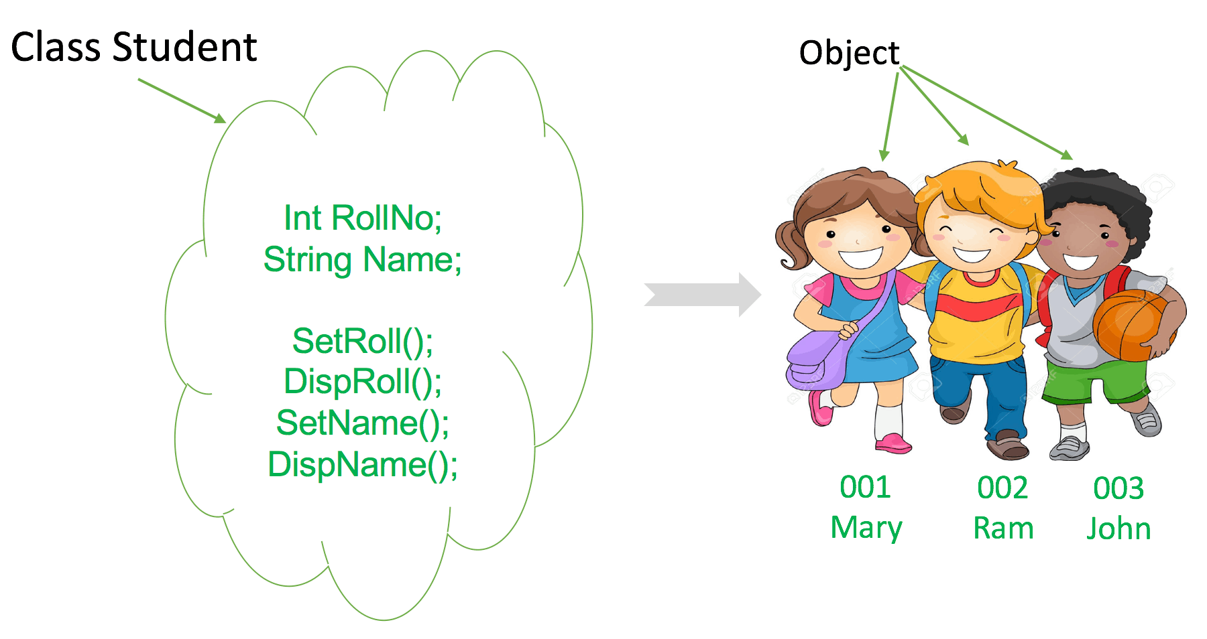
Example

Slide 12
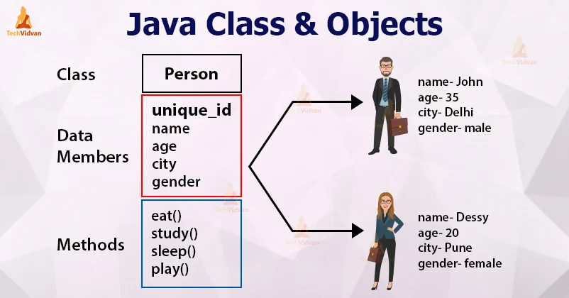
Example

Slide 13
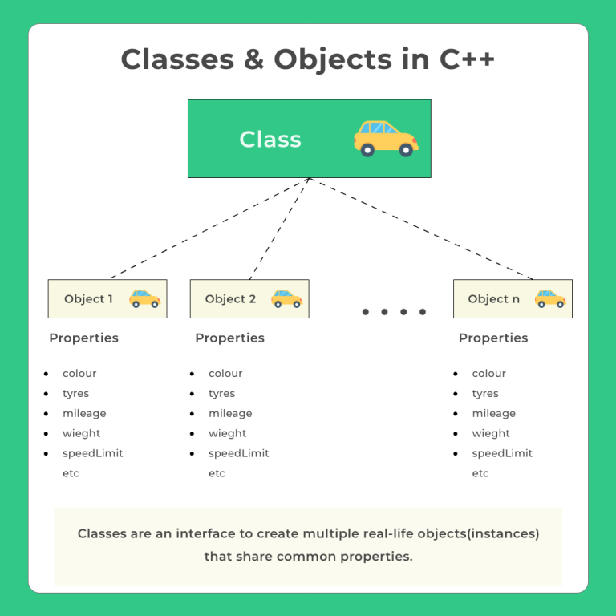

Slide 14
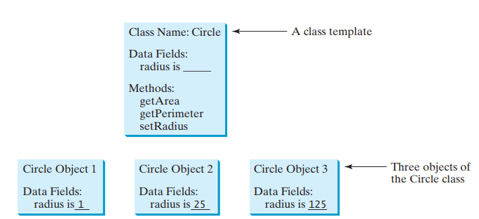
Class Example
Class circle has member variable x,y and radius of type integer and two member methods area and fillcolor

Slide 15
What are the four basic principles/ building blocks of OOP?
The building blocks of object-oriented programming are
Inheritance
Encapsulation
Abstraction
Polymorphism

Slide 16
Inheritance
When one object acquires all the properties and behaviors of a parent object, it is known as inheritance.
Inheritance uses a parent-child relationship
(IS-A relationship).
A class which inherits the properties is known as Child Class whereas a class whose properties are inherited is known as Parent class.
Parent Class : Dog
Child Classes : Pomeranian, Bulldog, Dobermann etc.
Inheritance supports the concept of “reusability”.

Slide 17
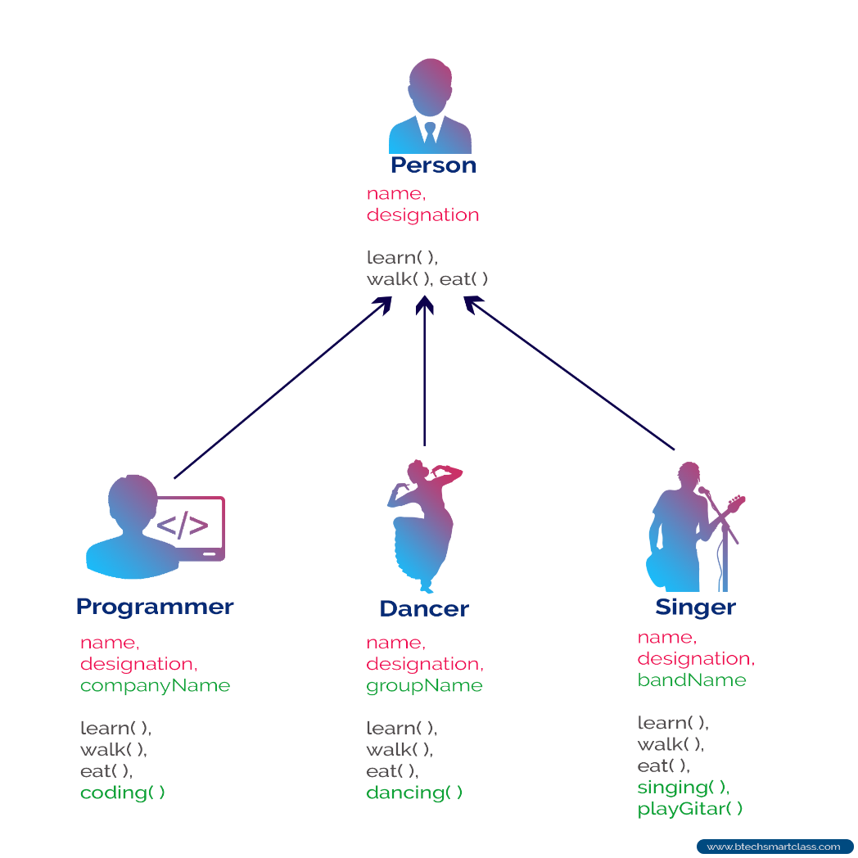
Inheritance

Slide 18
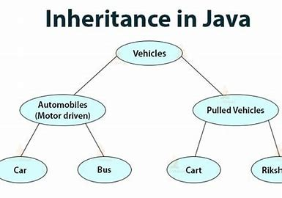
Inheritance

Slide 19
Encapsulation
Encapsulation is a process of wrapping code and data together into a single unit.
It also means to hide your data in order to make it safe from any modification.
Through encapsulation the methods and variables of a class are well hidden and safe.
We can achieve encapsulation in Java by:
  Declaring the variables of a class as private.
  Providing public setter and getter methods to modify and view the variables values.

Slide 20
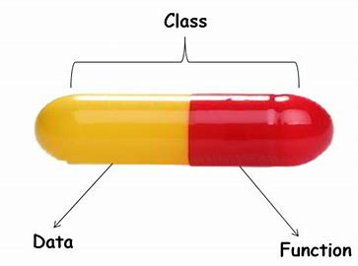
Encapsulation

Slide 21
Abstraction
Abstraction is a process of hiding the implementation details and showing only functionality to the user.
A common example of abstraction is that pressing the accelerator will increase the speed of a car. But the driver doesn’t know how pressing the accelerator increases the speed – they don't have to know that.
In Java, we can achieve abstraction in 2 ways:
  Abstract class
  Interface.

Slide 22

Abstraction

Slide 23
Polymorphism
Polymorphism is the ability of an object to take on many forms.
All the three classes in the image inherited the bowlingMethod() but their implementation is totally different from one another.
Polymorphism is achieved in Java using
  Method overloading
  Method overriding

Slide 24


